Slide 1
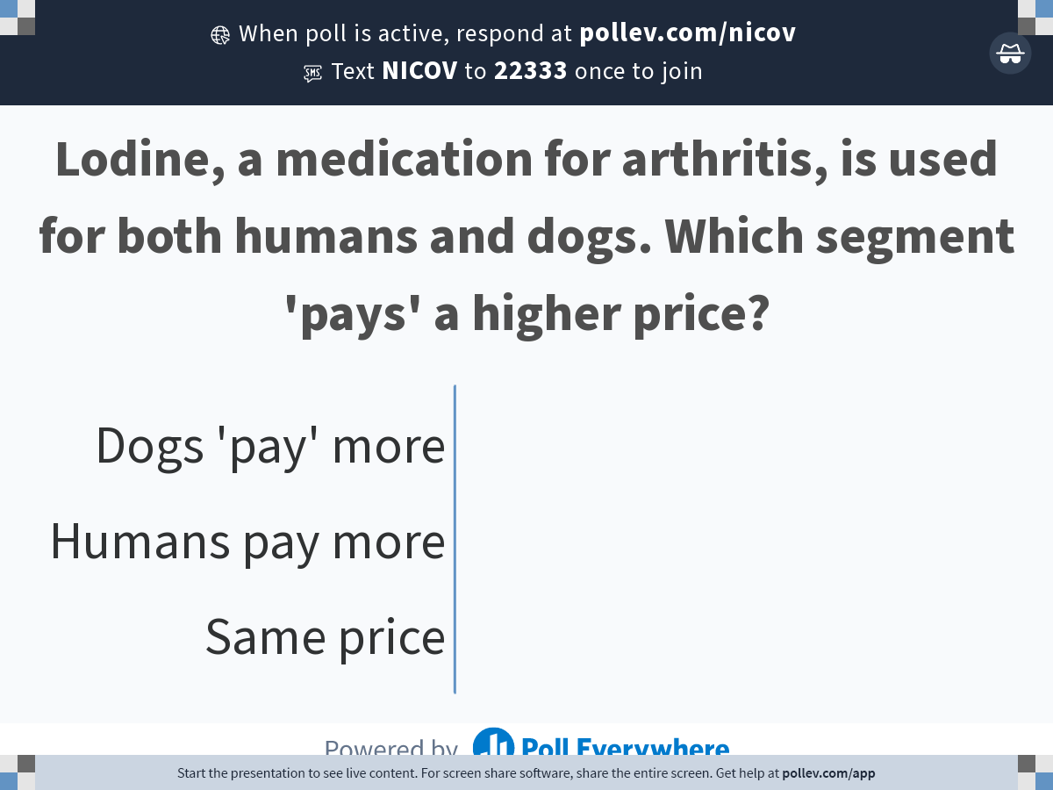
Notes:
Poll Title: Do not modify the notes in this section to avoid tampering with the Poll Everywhere activity.
More info at polleverywhere.com/support
Lodine, a medication for arthritis, is used for both humans and dogs. Which segment 'pays' a higher price?
https://www.polleverywhere.com/multiple_choice_polls/4BC5CeS5GrXrPVaYNwliJ?state=opened&flow=Default&onscreen=persist

Slide 2

Notes:
Poll Title: Do not modify the notes in this section to avoid tampering with the Poll Everywhere activity.
More info at polleverywhere.com/support
How should United respond to Southwest starting to offer flights on one of its routes?
https://www.polleverywhere.com/multiple_choice_polls/kTjbo3Qwc1lQNUuHpIZ8D?state=opened&flow=Default&onscreen=persist

Slide 3
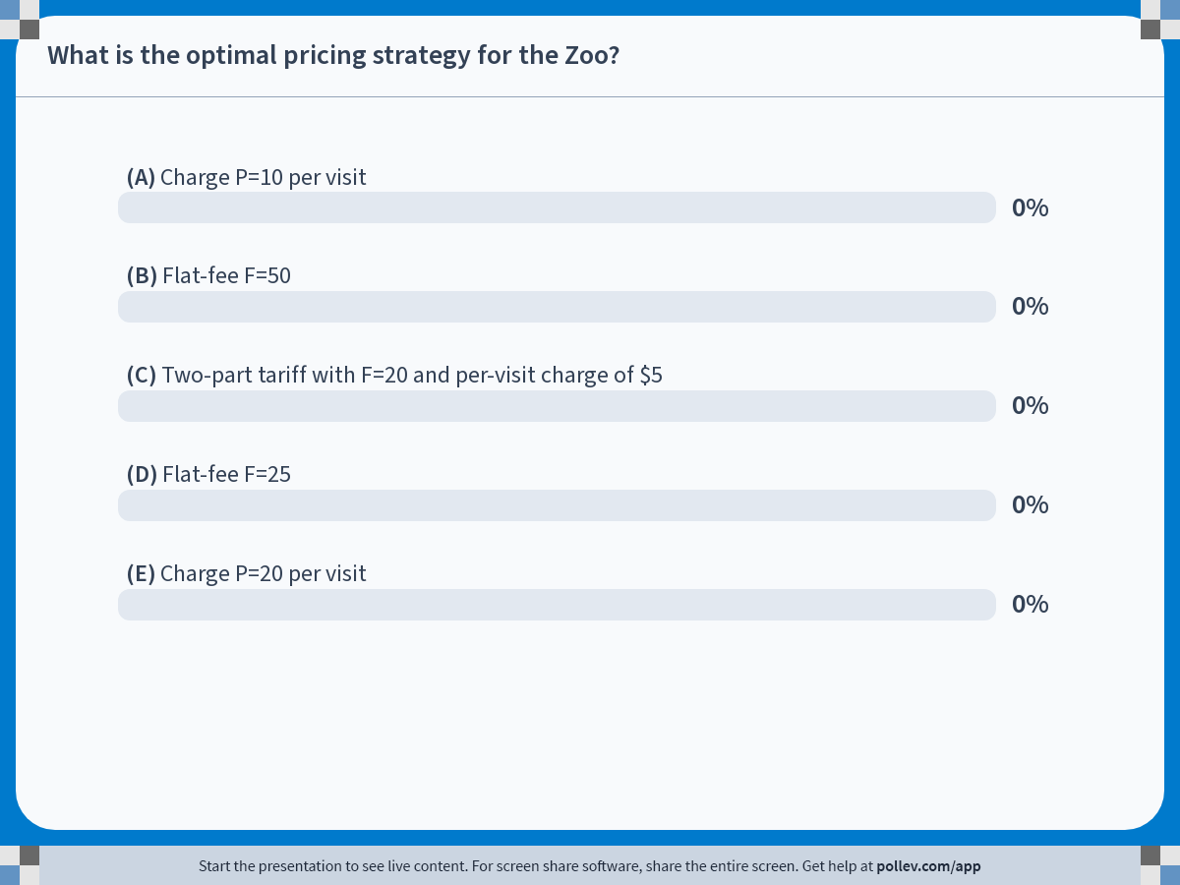
Notes:
Poll Title: Do not modify the notes in this section to avoid tampering with the Poll Everywhere activity.
More info at polleverywhere.com/support
What is the optimal pricing strategy for the Zoo?
https://www.polleverywhere.com/multiple_choice_polls/hmpajEICOBWnni2rKMoIs?state=opened&flow=Default&onscreen=persist

